Slide 1

Module 1: Foundation of Data Analytics Introduction to Data Analytics and Business Intelligence
Siddharth Sundar
MyAnatomy Integration
NCET Core Team

Slide 2

Business Intelligence?
Business, is like a game of chess. Players who think two steps ahead, are victorious. In the case of Business, they are “Profitable”.
But, why is that the case? Knowing “two-steps” ahead, allows individuals to take better decisions.
By Definition – “Business Intelligence refers to the set of processes and technologies that organizations use to collect, analyze, and interpret data to help with Decision-Making.”

Slide 3



Examples of Business Intelligence In Play
Amazon Recommendations
Google Targeted Ads
Amazon has vast amounts of user data like Age, Gender, Preferences, Purchasing Patterns, and more.
They use this data to analyse user purchasing trends and “recommend” different products to users.
For example – If you browse a Smartphone on your Amazon Account, it will give you recommendations saying “Users who bought this also bought…”
Google’s understanding of Consumer Behaviour is unparalleled. It is possible only through Data Analytics
They track user behaviour closely and understand the customers preferences and likings, making it easier for them to show the customer targeted ads.
For example – If you google “pet-related” products, you will soon start observing ads that are related to the same keywords.

Slide 4
Live Demonstration
Let’s see how we can do a short analysis and come up with interesting decisions as a business.

Slide 5

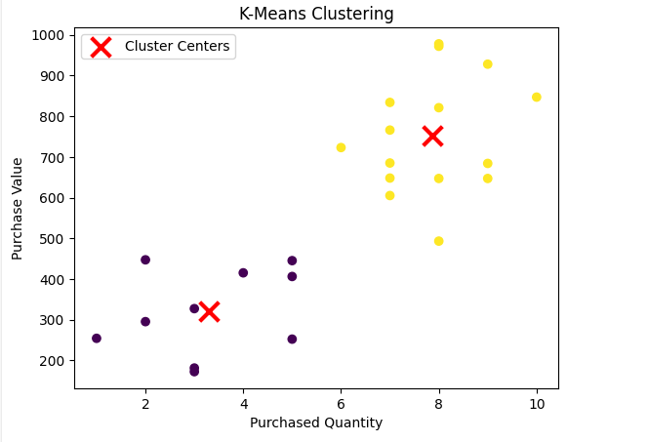

If you were Swiggy CEO, what decisions would you take?

Slide 6
If I were Swiggy CEO, here are the decisions I would take?
Understand that these two groups are:
High-Value Customers(Yellow)
Low-Value Customers(Purple)
For the ‘Low-Value Customers’:
Welcome back Coupons
Swiggy One at 1₹
Discounts on Popularly purchased items.
For the ‘High-Value Customers’:
Free Add-Ons to their purchases to retain the customer.
Ensuring that the delivery partner assigned is always prompt.
Premium Support and Assistance.

Slide 7

Data Analytics – What Does One Do?
Data Analytics and Business Intelligence Professionals often spend hours working on preparing data to extract insightful information for accurate “Decision-Making”.
The Previous Example is a simple explanation of how even a small piece of analytics can play a major role in making game-changing decisions that impact the overall profitability of any business.
Throughout this Training, we will learn how to upskill ourselves in these fields and progress towards becoming an Analyst.

Slide 8





Data Analytics – What Does One Do?
Problem Definition and
Ideation
Data Collection and
Preparation
Exploratory Data
Analysis
Communication and
Storytelling
Model Deployment and
Monitoring
Model Selection and
Training

Slide 9
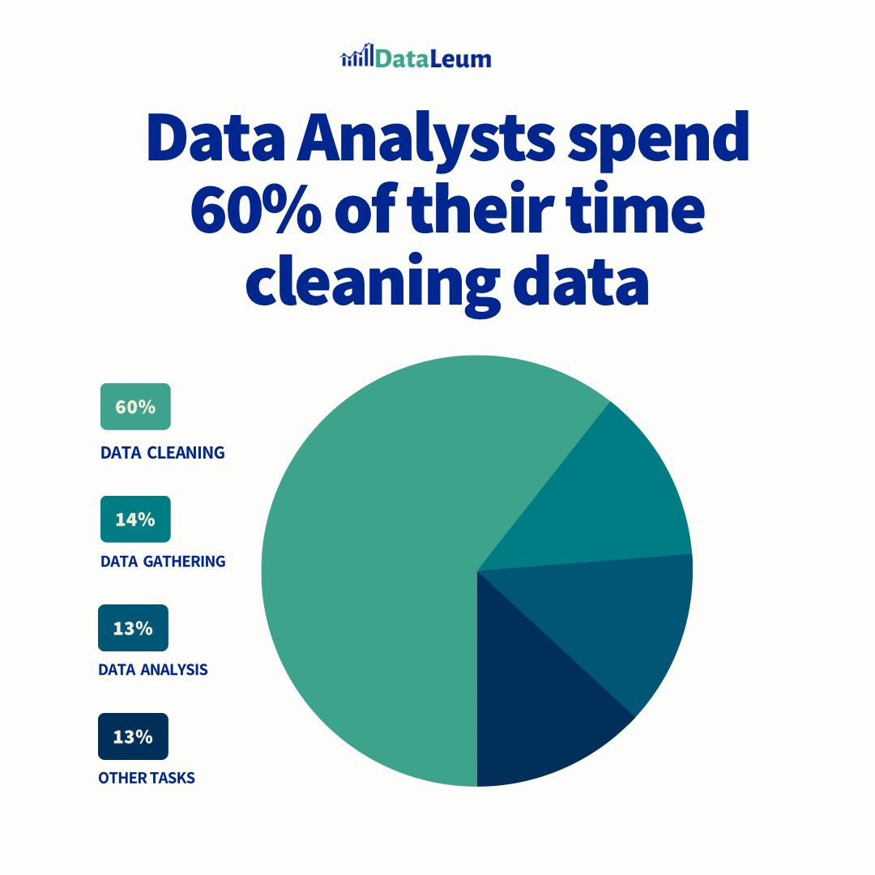
Data Analytics – What Does One Do?
Data Analysts spend 60% of their time cleaning data, according to various sources reported on the web.
Data Analysis, Model building, and Deployment, come in the other 40%.
Data Cleaning is the most important stage because if the data is clean, then it is irrelevant to do analysis with that data.
Data can be cleaned using Excel, Python, SPSS, and many other tools, but Excel is the most powerful weapon for an Analyst.
Source: DataLeum on X posted an interesting article.

Slide 10

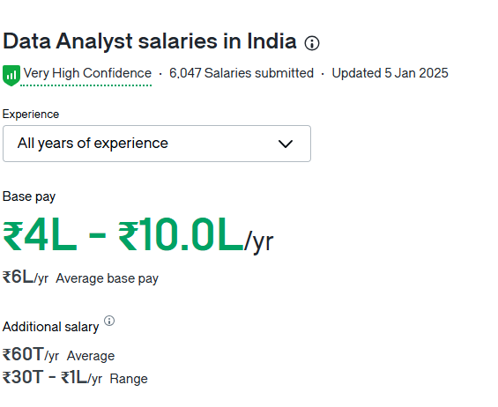
Data Analytics in 2025 – A Glance
Top Industries Hiring Data Analysts
Healthcare Analytics
Retail Analytics
Banking Analytics
Education Analytics
Manufacturing Analytics
Top Skills in Data Analysts
MS-Excel
SQL
Python/R
PowerBI/Tableau
Data Warehousing and Mining Tools

Slide 11

Data Analyst (Business Intelligence) – Course Curriculum
Module 4 (Foundation of AI/ML for Analytics)
Module 1 (Foundation of Data Analysis)
Introduction to Data Analytics and BI
End-to-End Process of an Analyst
Data Preparation with Excel
Introduction to AI and ML
Scikit Library, Tensorflow Library
Model Building using ML Algorithms
Model Evaluation
Module 2 (Data Visualization and Communication)
Module 5 (Hands-On Project)
Principles of Data Visualization
Data Visualization Tools
Interactive Dashboards and Storytelling
Project Scope and Requirement Analysis
Data Analysis and Modelling
Data Visualization and Reporting
Project Presentation
Module 3 (Statistical Analysis and Modelling)
Descriptive Statistics
Inferential Statistics
EDA using Excel and Python

Slide 12

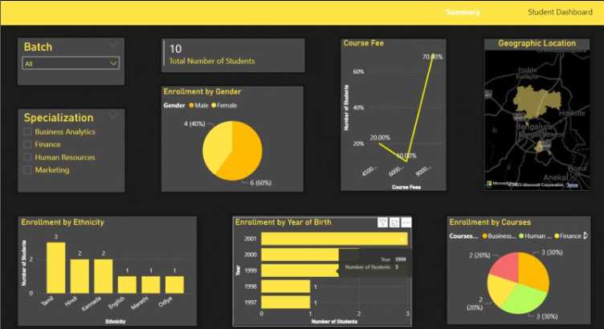
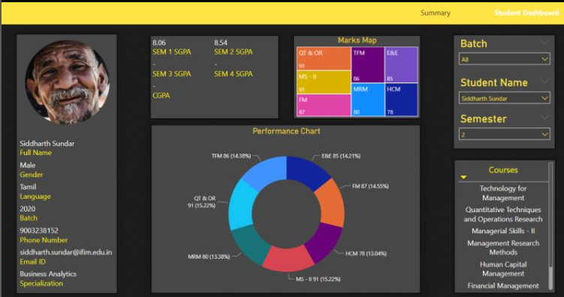
What Projects Will You Be Completing at the end of this Course?
Interactive PowerBI Dashboard for a College
Note: Students can choose either tool to build their project depending on their preference. I will be showing how to perform the project on both PowerBI and Tableau.

Slide 13

Quick Recap
Business Intelligence Definition
Business Intelligence Examples
Live Demonstration of K-Means Clustering for Swiggy Data
Decision Making using Model Built
Understanding decisions as Swiggy Stakeholder
Data Analytics – Daily Tasks
Data Analytics – Job Role Division
Data Analytics as a Job – Industry Insights
Course Curriculum for 30 Hour Workshop
Brief on Project
Q&A

Slide 14
Thank You
Q & A

